Slide 1
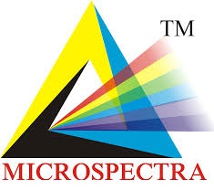
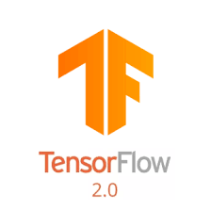

MICROSPECTRA SOFTWARE TECHNOLOGIES PVT. LTD.
INTRODUCTION TO
DATA SCIENCE ARTIFICIAL INTELLIGENCE
MACHINE LEARNING DEEP LEARNING
Topic:- Deep Learning(lect no:-7)
Certification & Internship Program

Slide 2
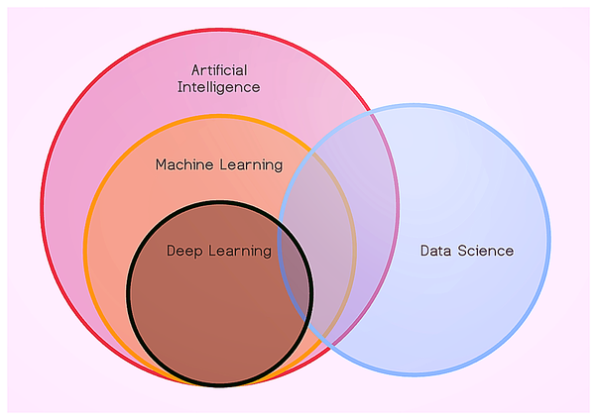
INTRODUCTION TO DEEP LEARNING
What Is Deep Learning?
ARTIFICIAL INTELLIGENCE
A technique which enables machine to mimic human behaviour.
MACHINE LEARNING
Subset of AI technique which use statistical method to enable machine to improve with experience.
DEEP LEARNING
Subset of ML which make the computation of multi-layer neural network feasible
DATA SCIENCE
Data science is an inter-disciplinary field that uses scientific methods, processes, algorithms and systems to extract knowledge and insights from many structural and unstructured data.
MICROSPECTRA SOFTWARE TECHNOLOGIES PVT.LTD

Slide 3
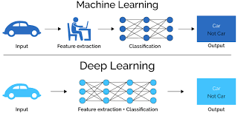
INTRODUCTION TO DEEP LEARNING
Difference Between Deep Learning & Machine Learning
MACHINE LEARNING
features have to be specified before feed to algorithms
DEEP LEARNING
model itself predicts for best features as per algorithms.
www.microspectra.in

Slide 4
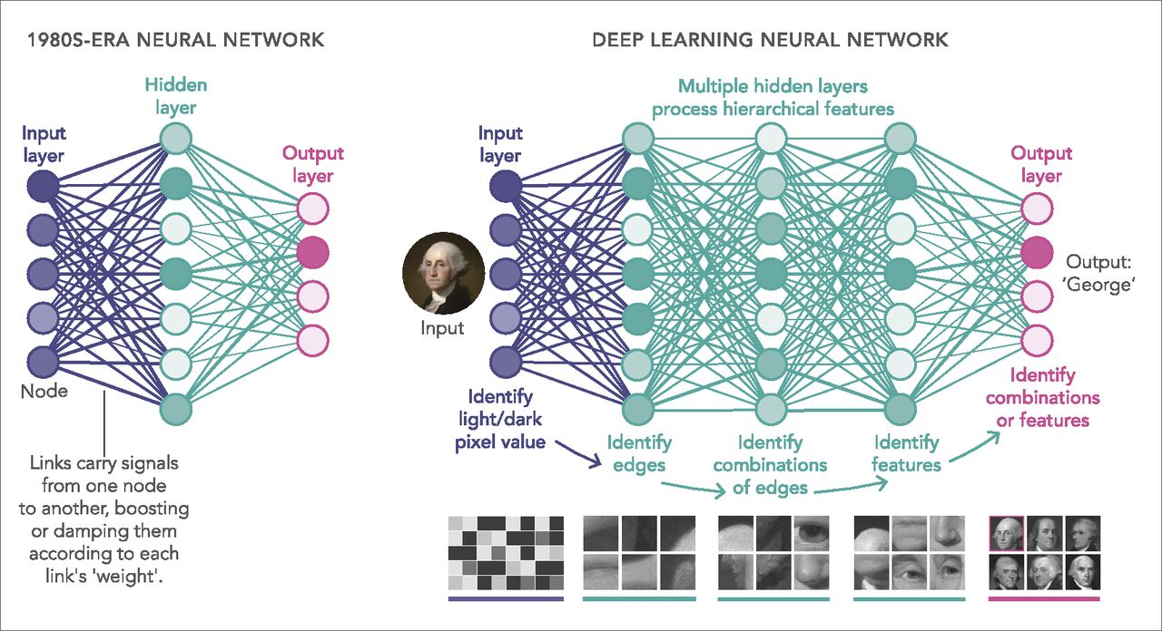
INTRODUCTION TO DEEP LEARNING
DEFINITION OF DEEP LEARNING?
Deep learning is a subset of machine learning in artificial intelligence (AI) that has networks capable of learning unsupervised from data that is unstructured or unlabeled. Also known as deep neural learning or deep neural network.
WHERE DATA MAY BE IMAGES, TEXT OR SOUND.
International Certifications & Internship Programs

Slide 5
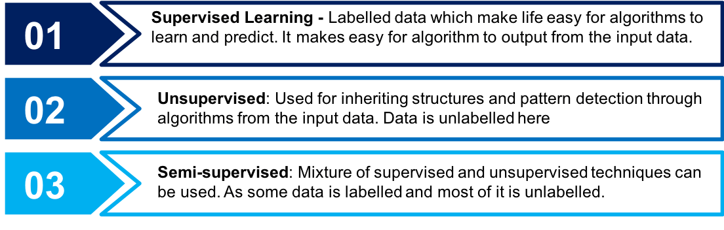
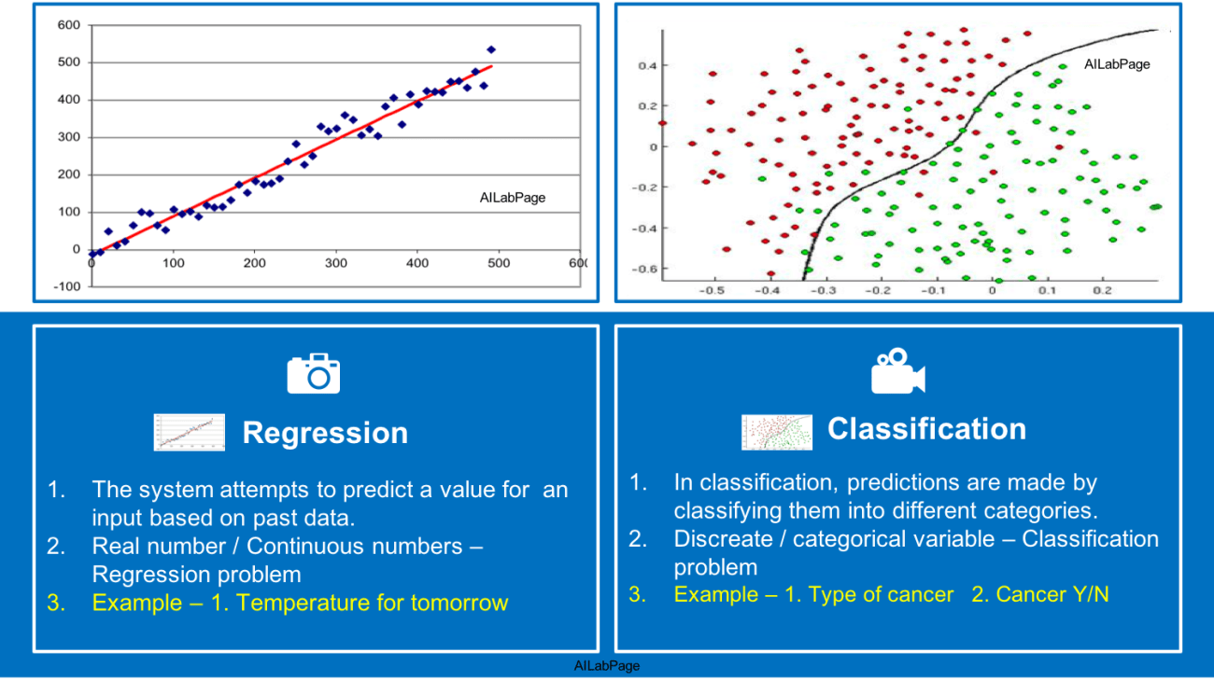
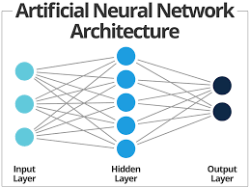
INTRODUCTION TO DEEP LEARNING
CATEGORIZATION OF DEEP LEARNING ?
Microsoft Technology Associate Certification In Python

Slide 6
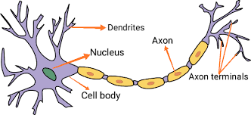
INTRODUCTION TO DEEP LEARNING
WHAT IS NEURON ?
Microsoft Technology Technology Associate In Web Development

Slide 7
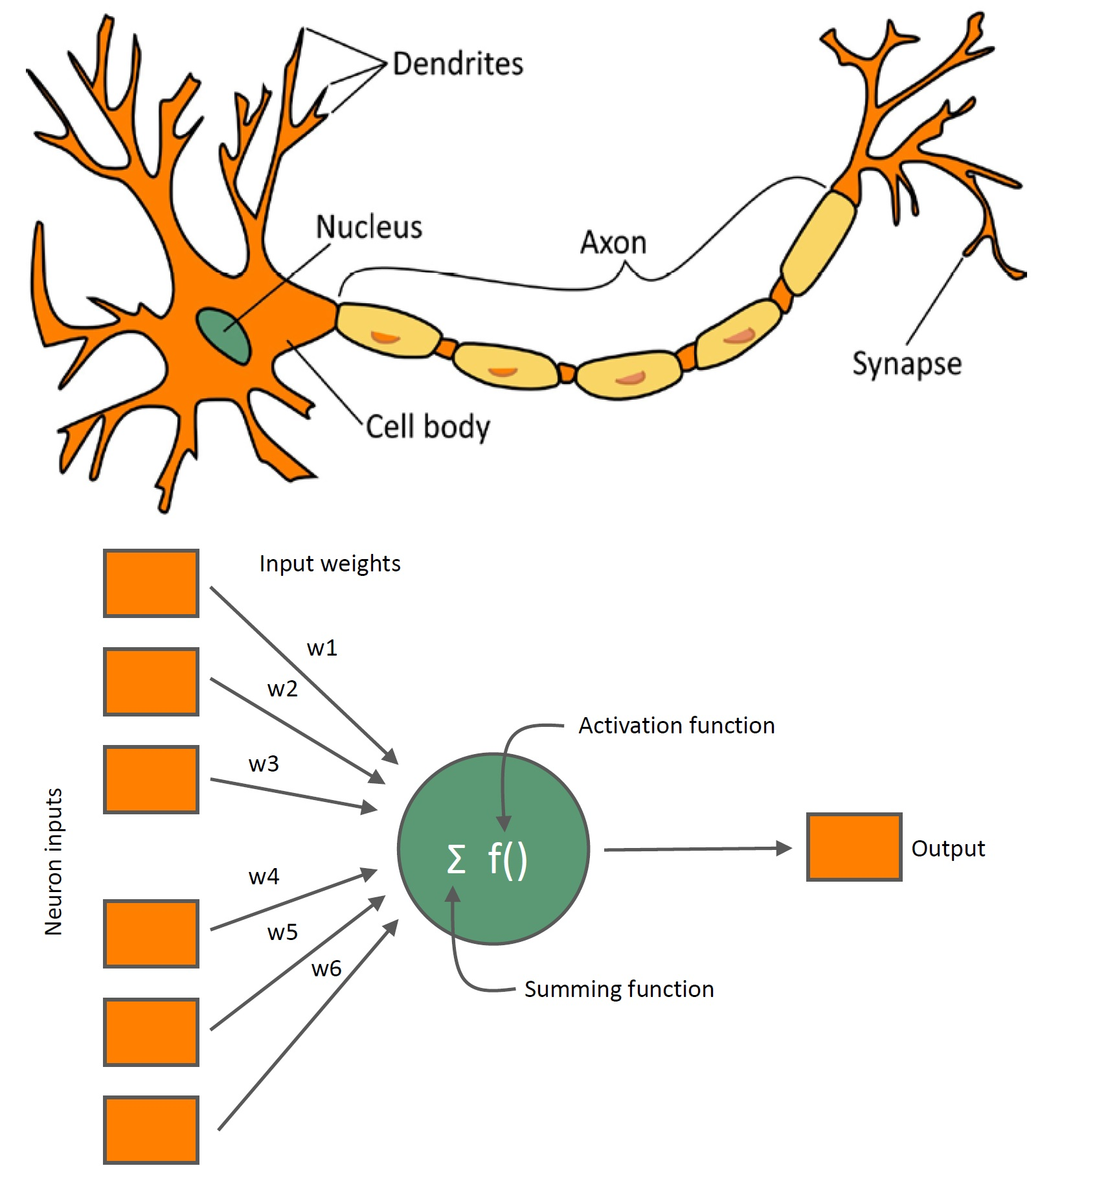
INTRODUCTION TO DEEP LEARNING
Perceptron In Deep Learning ?
Internship Progarm in AI, ML, DL, Data Science

Slide 8
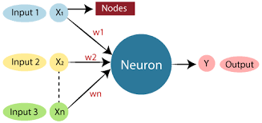
INTRODUCTION TO DEEP LEARNING
Perceptron In Deep Learning ?
Internship In Python Programming

Slide 9
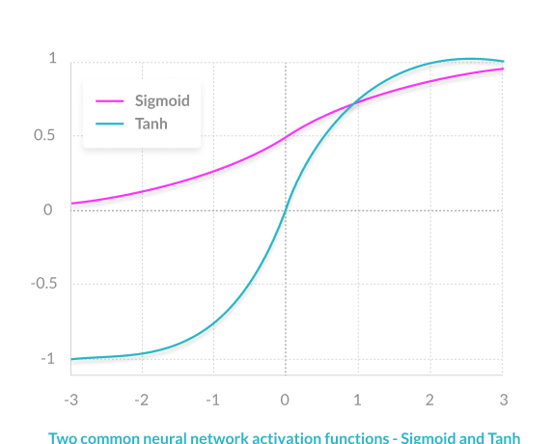
INTRODUCTION TO DEEP LEARNING
What is an Activation Function ?
Activation functions are mathematical equations that determine the output of a neural network. The function is attached to each neuron in the network, and determines whether it should be activated (“fired”) or not, based on whether each neuron’s input is relevant for the model’s prediction. Activation functions also help normalize the output of each neuron to a range between 1 and 0 or between -1 and 1.
Y = Activation(sum(weights*input)+ bias)
they must be computationally efficient because they are calculated across thousands or even millions of neurons for each data sample.
Non Linear Transformation.
Linear Activation Function.
Non Linear Activation Function.
Internship Progarm in Web Development

Slide 10
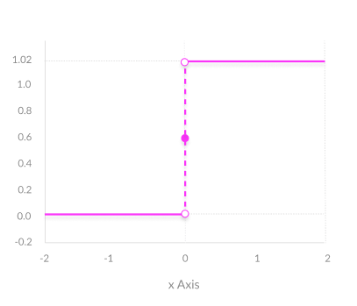
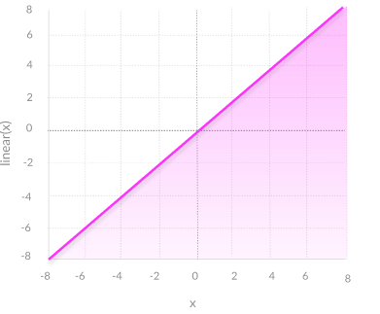
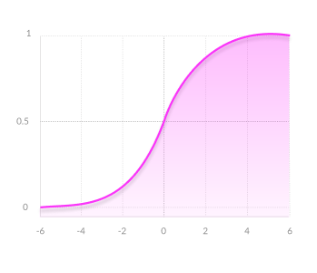
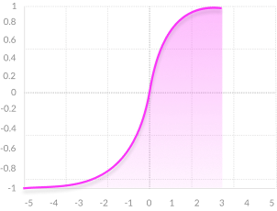
INTRODUCTION TO DEEP LEARNING
Type of Activation Function ?
Non-Linear Activation Functions
Modern neural network models use non-linear activation functions. They allow the model to create complex mappings between the network’s inputs and outputs, which are essential for learning and modeling complex data, such as images, video, audio, and data sets which are non-linear or have high dimensionality.
Binary Step Function
A binary step function is a threshold-based activation function. If the input value is above or below a certain threshold, the neuron is activated and sends exactly the same signal to the next layer.
Linear Activation Function
It takes the inputs, multiplied by the weights for each neuron, and creates an output signal proportional to the input. In one sense, a linear function is better than a step function because it allows multiple outputs, not just yes and no.
Learn and Implement Data Analytics with Microspectra.

Slide 11
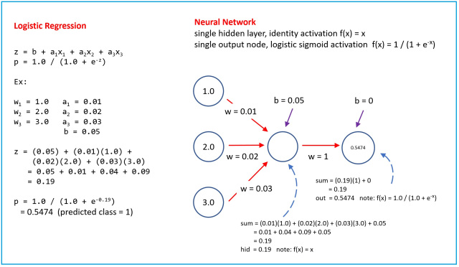
INTRODUCTION TO DEEP LEARNING
Activation Function Example
Internship in Internet of things(IoT)

Slide 12
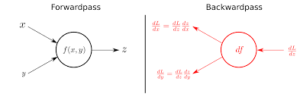
INTRODUCTION TO DEEP LEARNING
Forward and Back Propagation?
Mobile(Android & IoS )Application Development

Slide 13
INTRODUCTION TO DEEP LEARNING
What is Keras & TensorFlow
TensorFlow is an end-to-end open source platform for machine learning. It’s a comprehensive and flexible ecosystem of tools, libraries and other resources that provide workflows with high-level APIs. The framework offers various levels of concepts for you to choose the one you need to build and deploy machine learning models. For instance, if you need to do some large machine learning tasks, you can use the Distribution Strategy API in order to perform distributed hardware configurations and if you need a full production machine learning pipeline, you can simply use TensorFlow Extended (TFX). Some of the salient features are described below:
Easy Model Building
Robust ML Production Anywhere
Powerful Experimentation For Research
Keras on the other hand, is a high-level neural networks library which is running on the top of TensorFlow, CNTK, and Theano. Using Keras in deep learning allows for easy and fast prototyping as well as running seamlessly on CPU and GPU. This framework is written in Python code which is easy to debug and allows ease for extensibility. The main advantages of Keras are described below:
User Friendly
Modular and Composable
Easy To Extend
Easy To Use
Internship in Mobile Application Development

Slide 14


